Slide 1
EDUC2323 Computer Programming as a Tool for Learning
Computers as Objects to Think With

Slide 2
Overview
Computers as Objects to Think With
The ‘microworld’ concept
Case studies microworld in education – what does it offer?

Slide 3
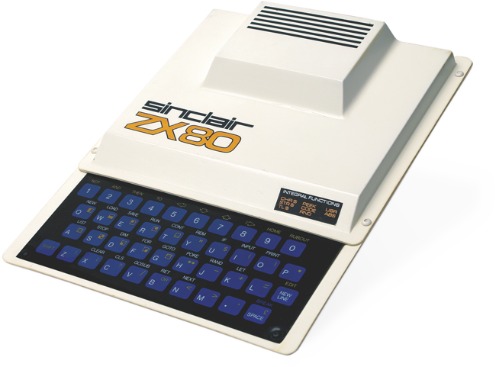
Computers as Objects to Think With
I was the second person at school to own a computer
The ZX80
1K of memory
no hard disk drive (tape recorder option)
no mouse
no sound
poor graphics
when you ran a program, the screen would go black (no monitor, you had to put it through the TV set)

Slide 4
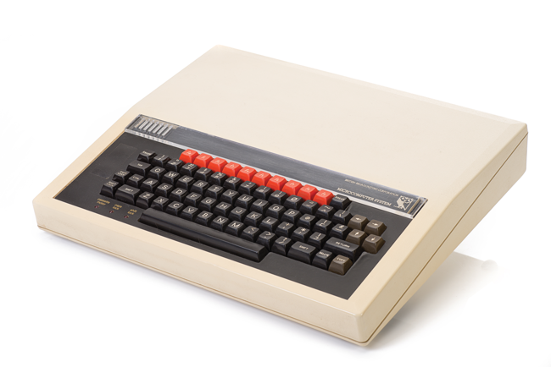
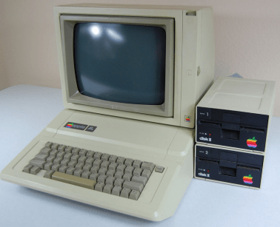
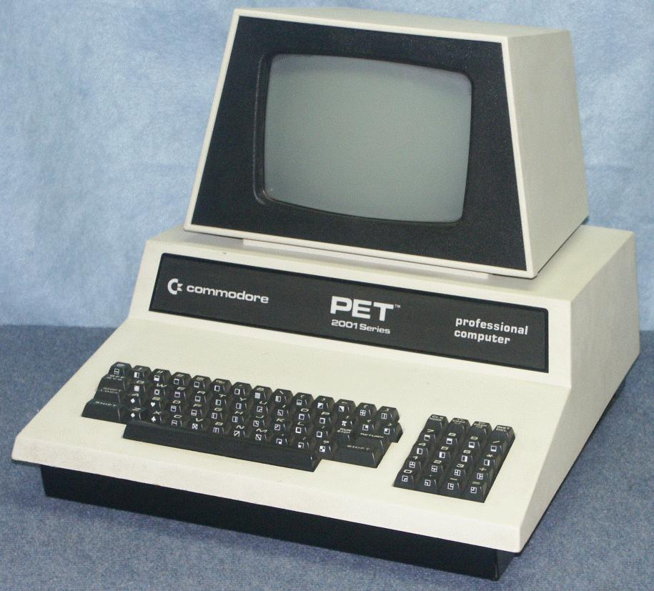
Gradually Other Computers Appeared
The BBC Micro
The Apple IIe
Commodore PET

Slide 5
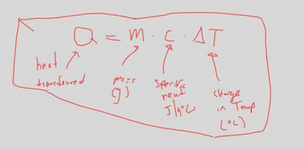
Physics Homework
ZX80 didn’t handle decimals

Slide 6
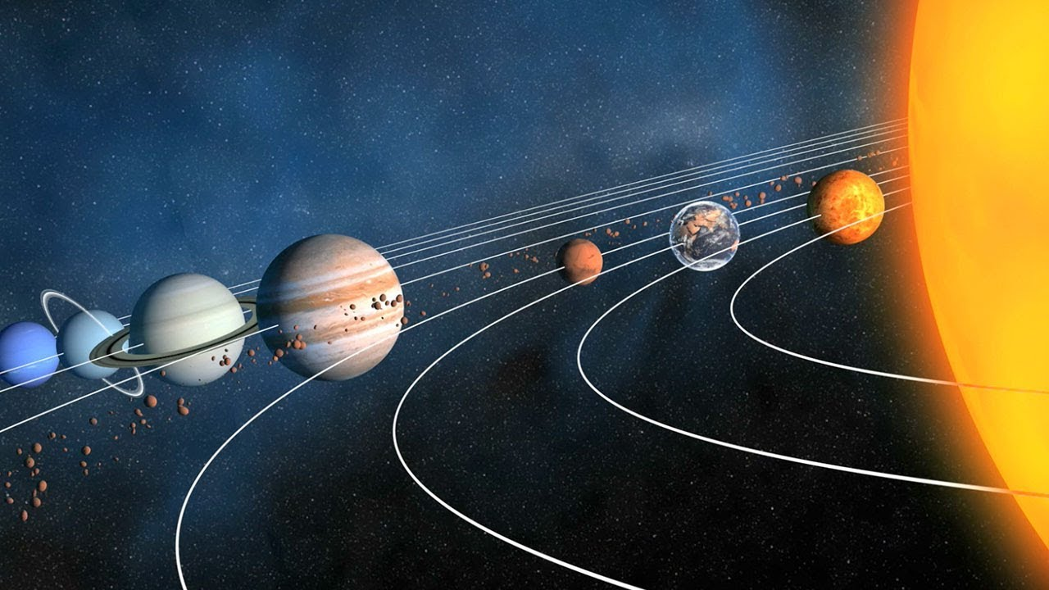
Size of the Solar System

Slide 7
What is a ‘microworld’?
“
a “place”, a “province of Mathland”, where certain kinds of mathematical thinking could hatch and grow with particular ease. The microworld was an incubator... The design of the microworld makes it a “growing place” for a specific species of powerful ideas or intellectual structures. (Papert, 1980, p. 125)
“
environments where people can explore and learn from what they receive back from the computer in return for their exploration. It
follows, therefore, that a microworld has its own set of tools and operations that
are open for inspection and change. In this sense, learners themselves are in
the position simultaneously of user and designer…
(Hoyles et al, 2002: 30)
“
“

Slide 8
Take a Break
3x handouts
Each is summary of microworld-based research case study
Highlight benefits for learners from engaging with microworld environments
Highlight challenges, cautions or limitations identified by researchers

Slide 9
Key features of microworlds
Models mathematical or physical properties of a particular ‘domain’
But ‘micro’ because some more complex aspects of the ‘real’ domain have been left out – i.e. simplified reality
Users can interact with microworld to change these properties and receive feedback on the results – i.e. they naturally promote exploratory/discovery learning
The process is managed/scaffolded by the teacher – this is not free play, but a semi-guided process because the ‘world’ has been set up

Slide 10
Finally
For Your Assignment
You could create a microworld
You can certainly discuss the idea if appropriate
It is always worth considering the classroom setting for your project idea

